Slide 1
Elasticsearch
Chp4: Search Your Data

Slide 2
Structure of Cluster indexes and Documents
Cluster
Index
Index
DOC
DOC
DOC
DOC
DOC
DOC
DOC
DOC
DOC
DOC
DOC
DOC
DOC
DOC
DOC
DOC
DOC
DOC
DOC
DOC
DOC
DOC
DOC
DOC
DOC
DOC
DOC
DOC
DOC
DOC
DOC
DOC
Notes:
Indexes live in the cluster document live in indexes

Slide 3
Storing a Document
Verb
Index
Type
ID
curl –XPUT http://localhost:9200/literature/quote/one -d’
{
“person”: “Jack Handy”
“said”: “The face of a child can say it all, especially the mouth part of the face”
}’
Curl commands documentation: https://curl.haxx.se/docs/manpage.html

Slide 4
Document example 1
{
“person”:”Sam”,
“foods”:[“Green eggs”, “ham”]
“likeswith”: {
“place”: “house”,
“companion”: “mouse”
“age”: 10
}
}

Slide 5
Document example 2
{
“human” : {
“properties” : {
“person” : {“type” : “string”},
“age” : {“type” : “integer”}
}
}
}

Slide 6
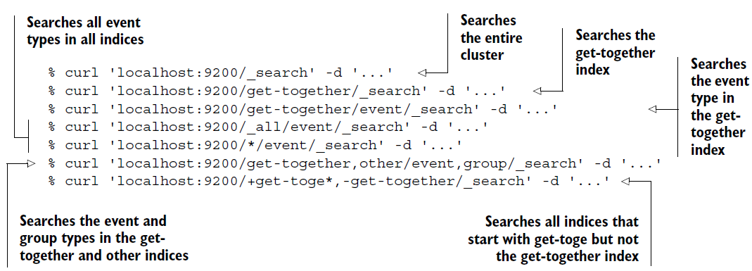
Search Request
JSON document based
URL Based Request
Notes:
Elasticsearch search requests are:
All follow the same format

Slide 7
Curl simple Query
Verb
Index
Type
Action
Curl –XPOST http://localhost:9200/literature/quote/_search –d’
{
“query”: {
“match”: {
“person”: “jack”}}
}

Slide 8
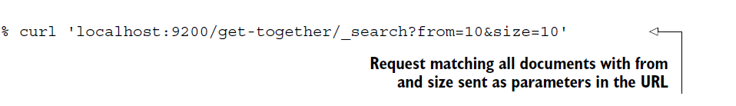
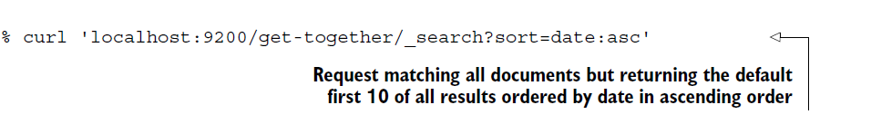
Basic Components of Search Request
query – structure by query DSL, filter DSL
size – amount of document to return
from – start from, for pagination, usually use with size
_source – specify how your source field going to be return
sort – helps you to control which documents get returned, default base on score
Descending(desc)
Notes:
_source: store the original Json format but not indexed
Sort: could also be base on index

Slide 9
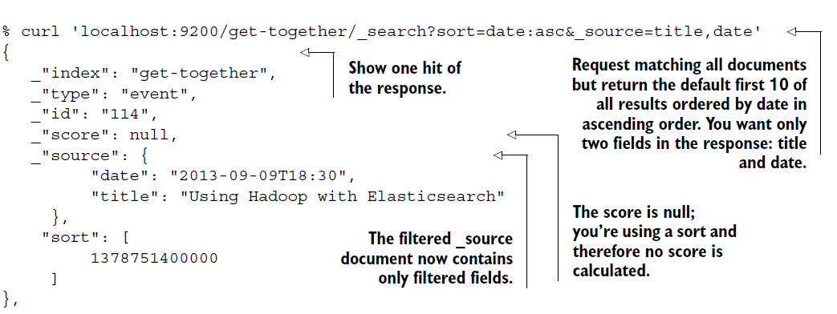
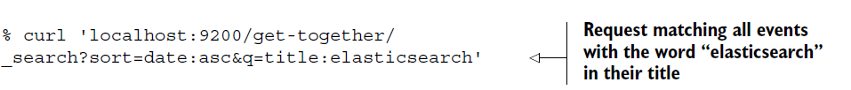
URL-Based Search Request Examples
Notes:
q= you indicate you want to provide a query in the search request with the title: elasticsearch

Slide 10
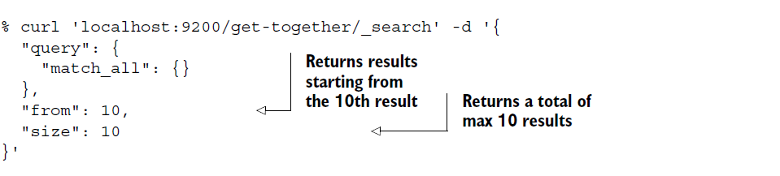
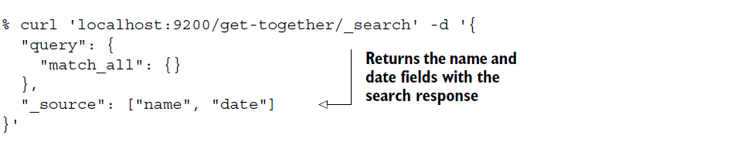
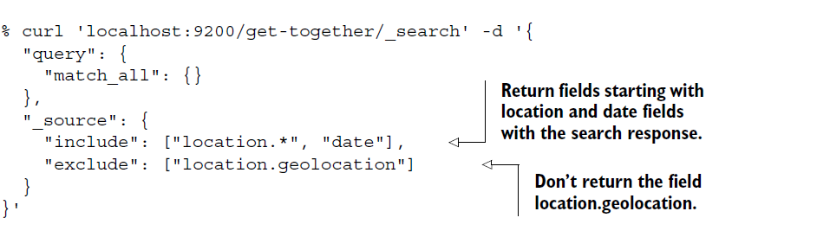
Body-base search request

Slide 11
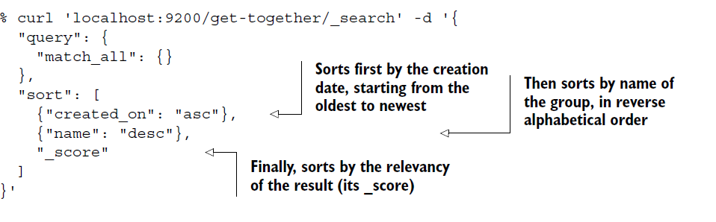

Slide 12
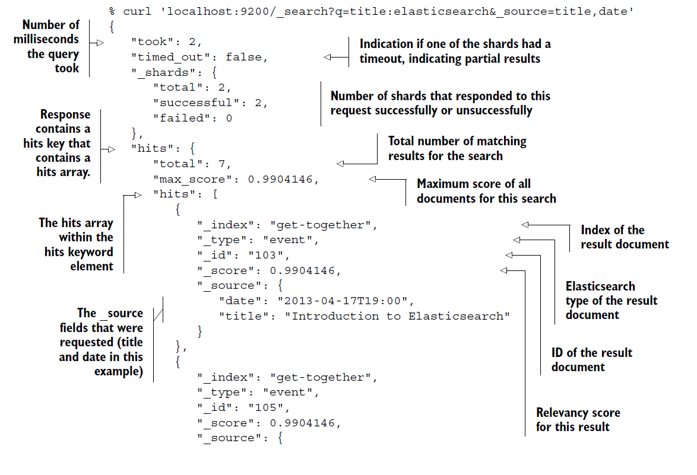
Query Response

Slide 13
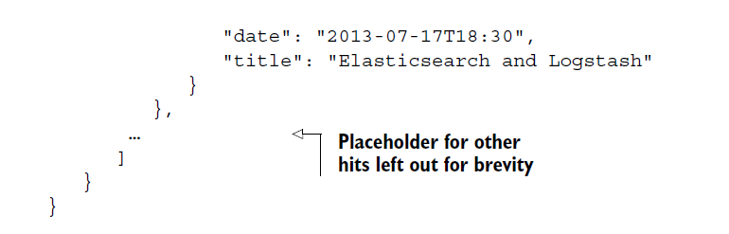

Slide 14
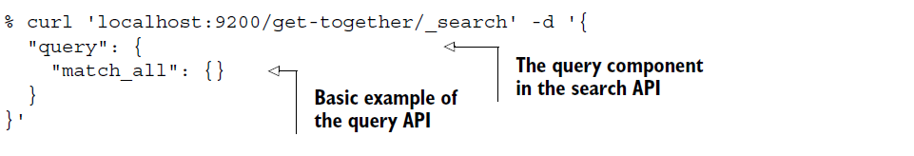
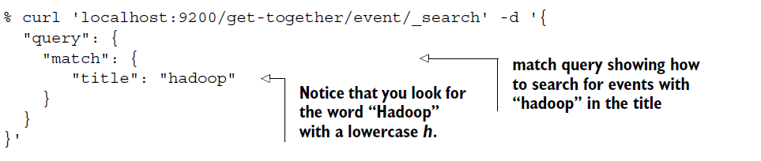
Match Query

Slide 15
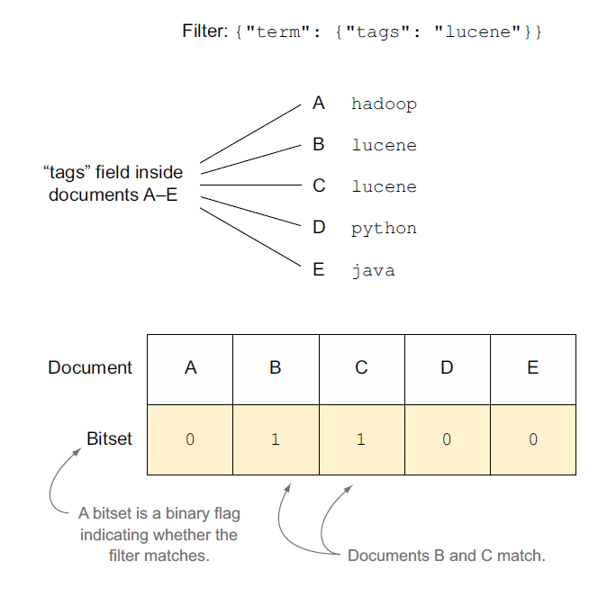
Filter Bitsets

Slide 16
Must Query
must: the search must match with the condition user gave
must_not: the search must not match with the condition user gave, which mean the opposite of what users ask for

